Slide 1


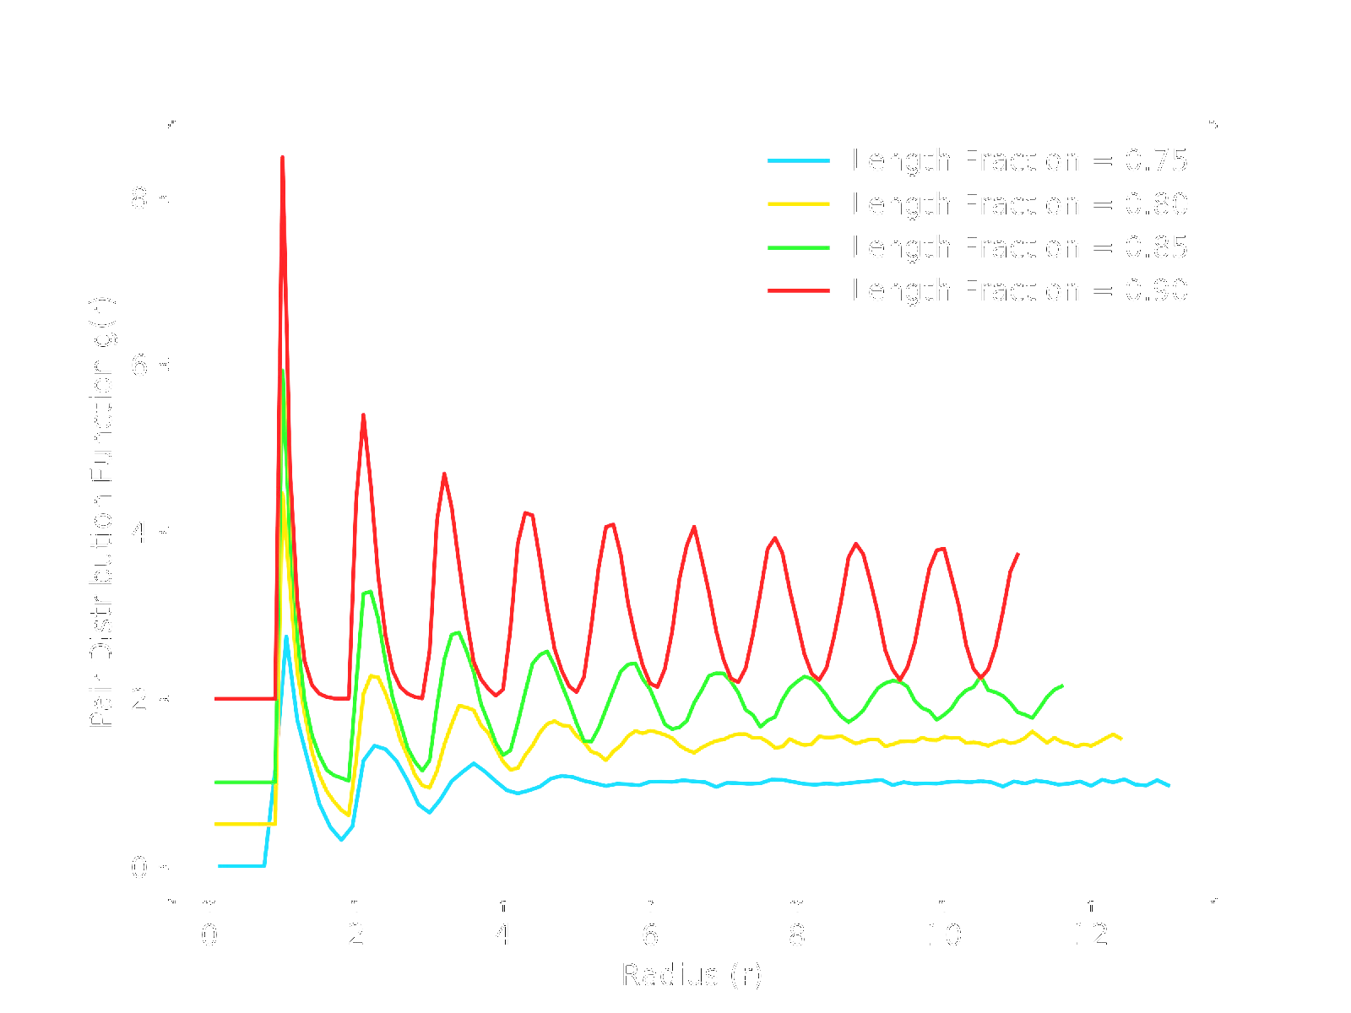
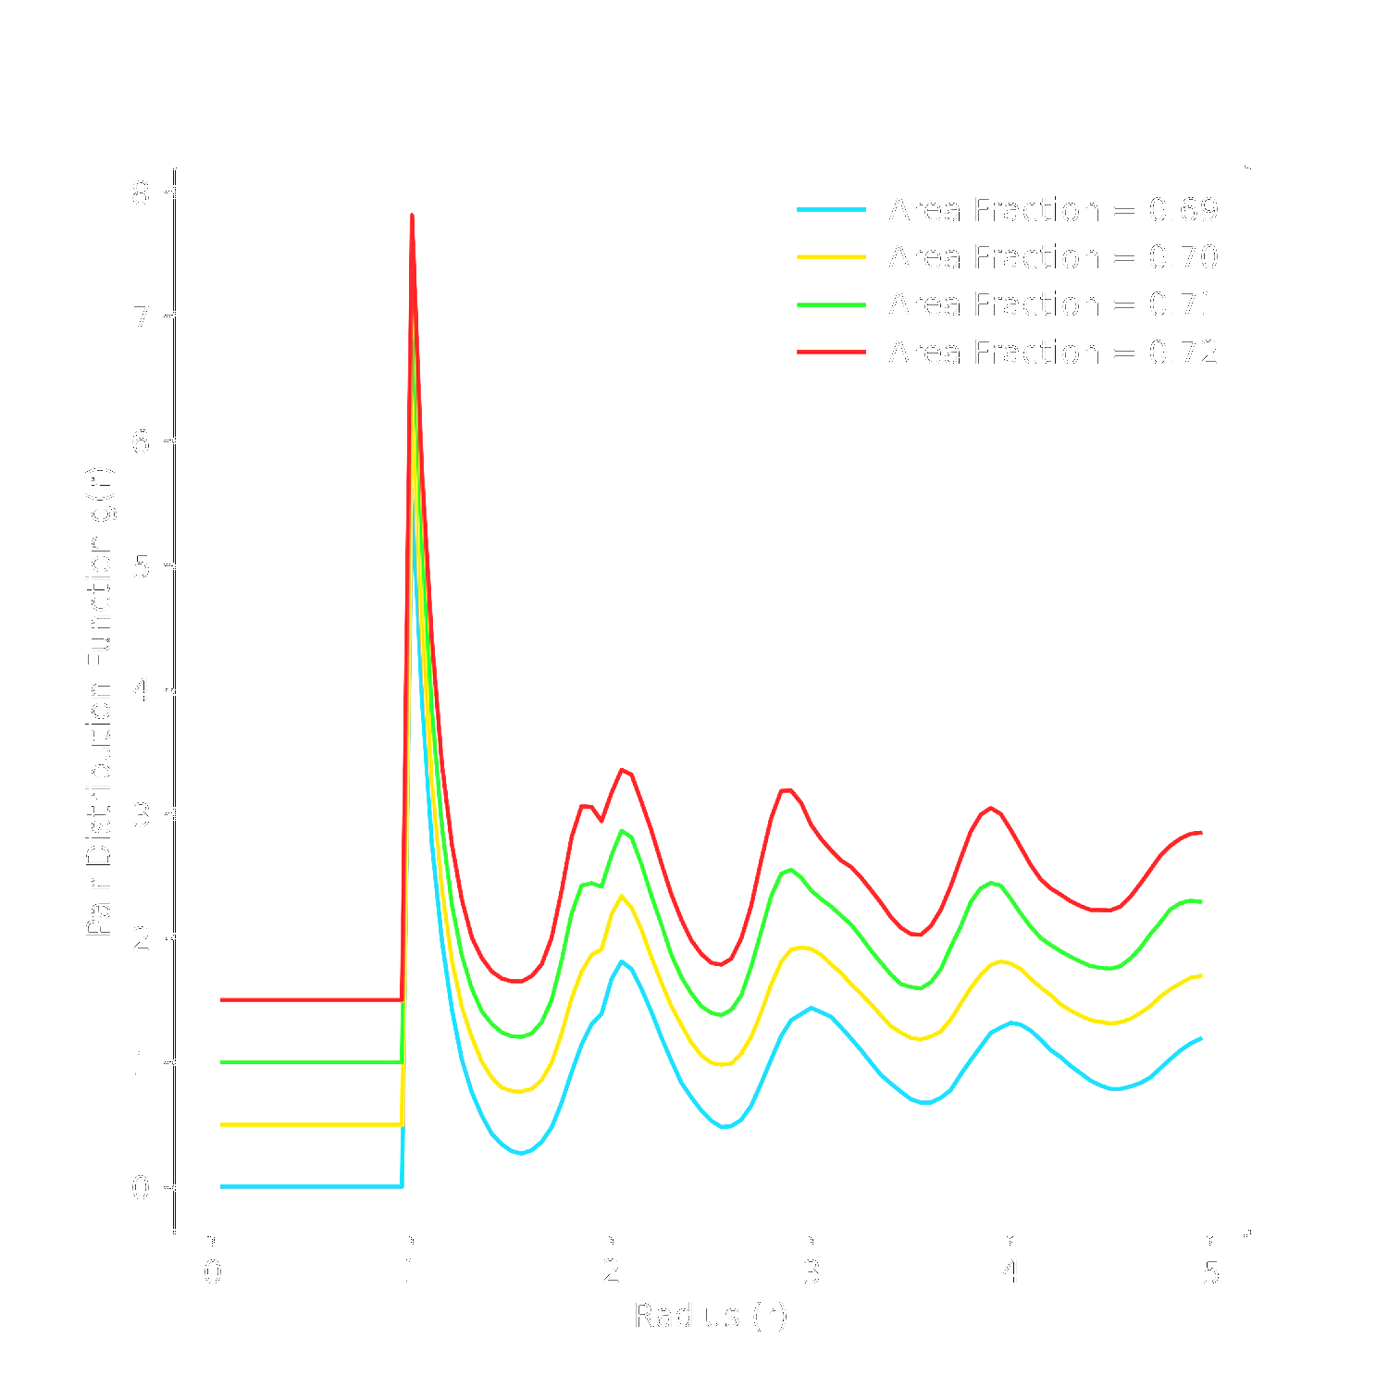

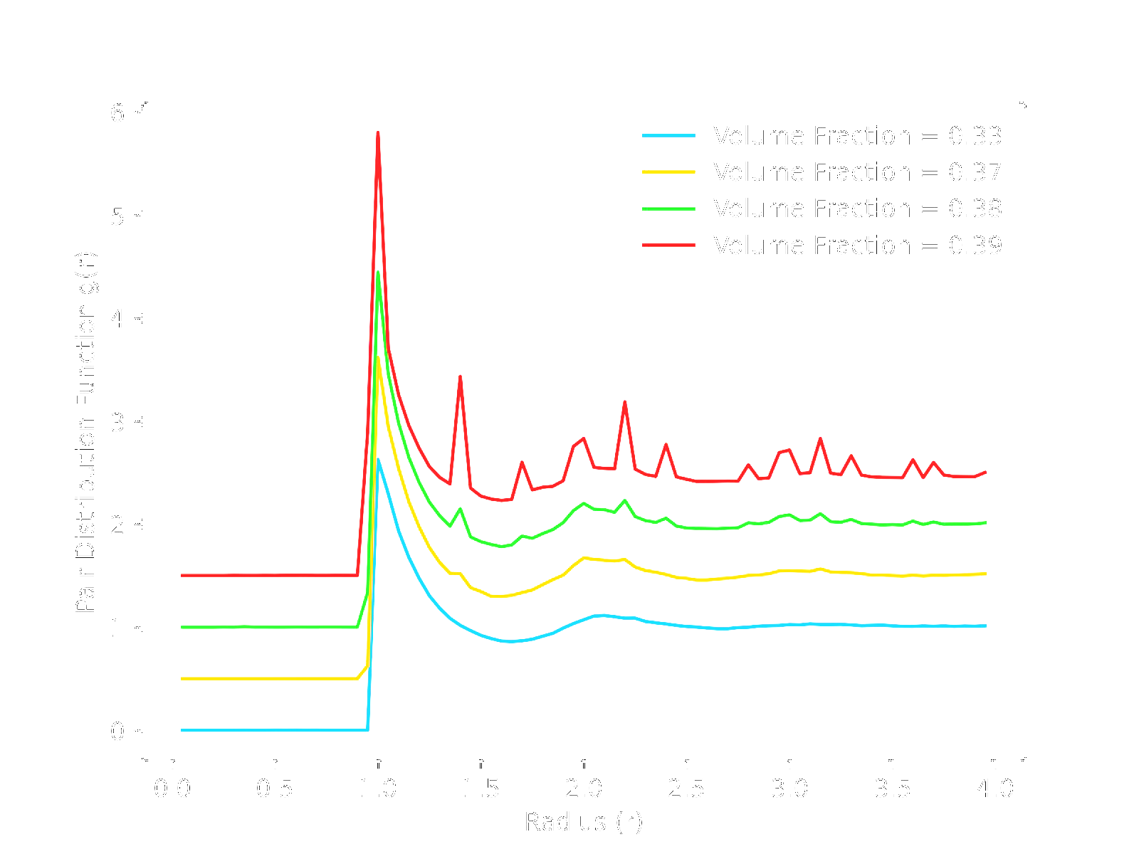

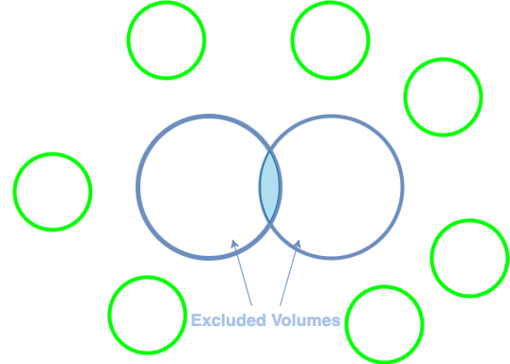
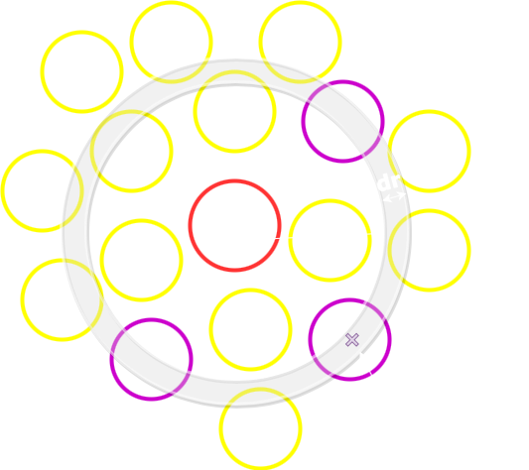
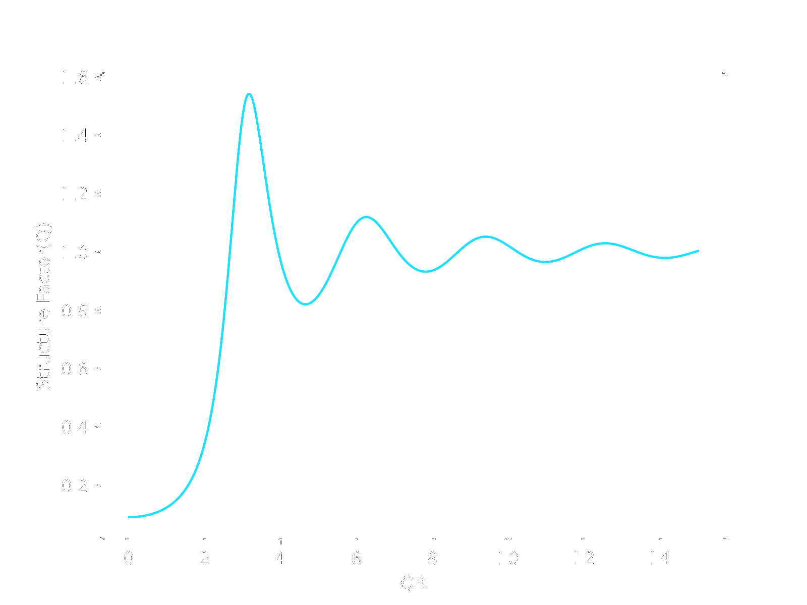
Thomas Matheickal
Department of Physics
Durham University
February 2021
Simulating Hard Sphere Interactions in Multiple Dimensions
This project aims to investigate hard sphere interactions in multiple dimensions by using Monte Carlo simulations to analyse their structural signatures and learn more about liquid-solid phase transitions and the processes that drive them
Hard Sphere Model
Dimensionality Plots
Hard spheres act as model particles, defined as impenetrable spheres which do not interact and cannot overlap each other. By simulating their interactions within a confined space, we can learn more about the processes that drive their phase transitions
1D
2D
Monte Carlo Simulation
3D
1D - Particles show no sign of a liquid-solid phase transition and lose long-range order at lower packing fractions quickly.
2D - Appearance of new bump around area fraction 0.70 signifies a liquid-solid phase transition.
3D – Shows signs of crystallization around volume fraction 0.39 as shown by numerous sharp peaks. PDF tends to unity quicker than other dimensions meaning very little long-range order
The Monte Carlo Simulation uses an algorithm that relies on repeated sampling to obtain the properties of the system averaging over the possible states. As there are too many states to visit using the hard sphere model, random sampling is used to predict the information the system holds [1].
Pair Distribution Function
Depletion Force
The structural significance of the liquid-solid phase transition can be analysed by calculating the pair distribution function for each configuration of the hard spheres. The function describes how density varies as a function of distance from a reference particle and is normalized by the bulk density of the system.
The peaks shown in the plots suggest an inherent attractiveness between the particles. This is due to an entropy driven process called the depletion force. Each particle has a space around them called the excluded volume where the centre of another particle cannot be positioned. When the excluded volumes intersect, the space available to other particles around them increases. Other particles fill this space and exert an osmotic pressure onto the close particles forcing them together. This effective attraction in fact due to the indirect repulsion of other particles [3].
References
[1] Chandler, David. Introduction to Modern Statistical Mechanics. Oxford University Press, (1987)
[2] Level 3 PHYS3561 Computing Projects, Computing Projects Booklet, 2020/21 Dr C. Zambon
[3] Marenduzzo, D et al. “force driving cellular organizatThe depletion attraction: an underappreciated ion.” The Journal of cell biology vol. 175,5 (2006)
[4] Hammouda, B.. “Probing Nanoscale Structures – the sans Toolbox.”, Chapter 32, (2008).
It achieves this by counting the number of particles within a shell of thickness dr at increasing distances r away from the reference particle. This process is repeated for each particle and averaged out to create a plot [2].
Future Work: Percus-Yevick Approximation
Structure factor can be thought of as encoding the structural information of a system. The Percus-Yevick approximation can be used for hard spheres to achieve an analytical solution for the structure factor by Fourier transforming the pair distribution function in 1D and 3D [4]. Future work includes investigating if this approximation holds for these dimensions with varying packing fractions

